Slide 1
JFLAP
Automata Theory

Slide 2
What is Automata?
An Automaton is a construct made of states designed to determine if an input should be accepted or not.
Each state contains information about what to do when an input is received. Once that input is received it picks a new spot based on that information and moves to the next state.
Once there are no more inputs, the automata stops, and either rejects or accepts the set of inputs based on what spot it stopped on.

Slide 3
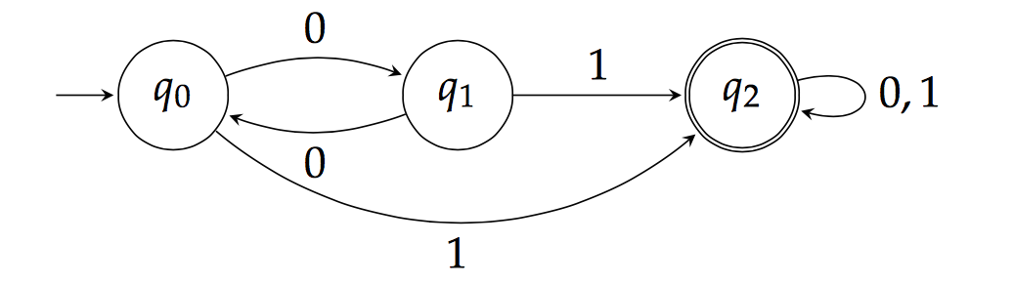
A basic Finite-State Automata

Slide 4
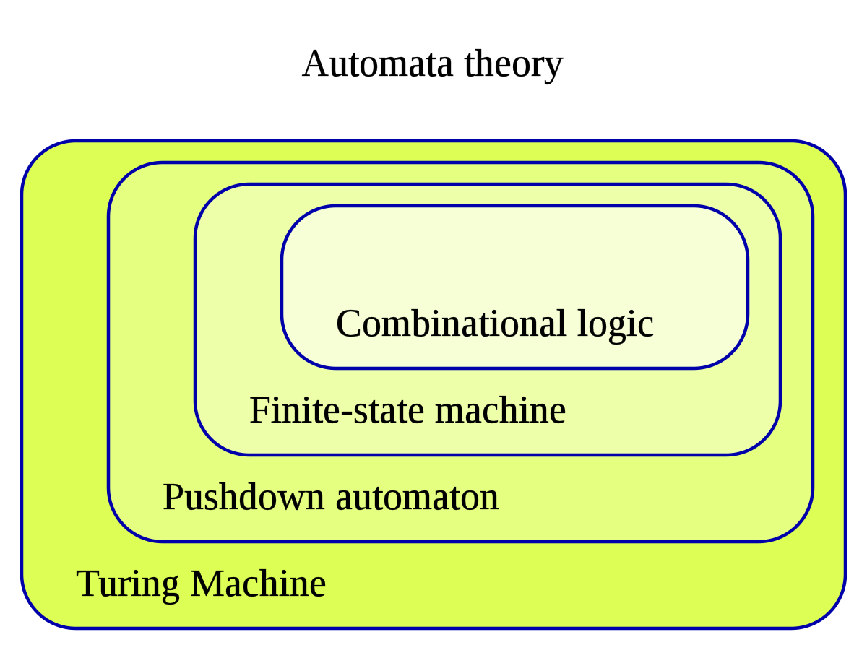
Finite-State Automata
Finite-State and Pushdown Automata are the beginning stages of Automata Theory.
We use JFLAP to depict Finite-State and Pushdown Automata.

Slide 5
Why do I care?
Automata are the most basic models to reason about programs and computation.
Variants and extensions of finite automata are widely applicable:
XML Processing
REGEX Processing
Static Analysis of Programs
Natural Language Processing
We are going to use JFLAP to build and test these Automata.

Slide 6
Finite-State Automata
A Finite-State Automata consists of the Following:
Q : The Finite set of States,
Σ : The set of Input Symbols,
q : The initial State,
F : The set of Final States,
δ : The Transition Function
This set of definitions describes how a Finite-State Automata works.
There are two types of Finite-State Automata:
Deterministic Finite Automata (DFA)
Nondeterministic Finite Automata (NFA)
In the Chomsky Hierarchy, it is a tier 3, meaning that Finite-State automata accept regular Grammars.

Slide 7
Regular Grammars
A Regular Grammar consists of the following:
A finite set, N, of nonterminal symbols.
A finite set, Σ, of terminal symbols.
A finite set, P, of production rules, each rule of the form:
(Σ U N)* N(Σ U N)* -> (Σ U N)*
Note: Kleene Star (*) means 0 or more.
S, where S is the start symbol.
Finite State Automata ONLY accept Regular Grammars.

Slide 8
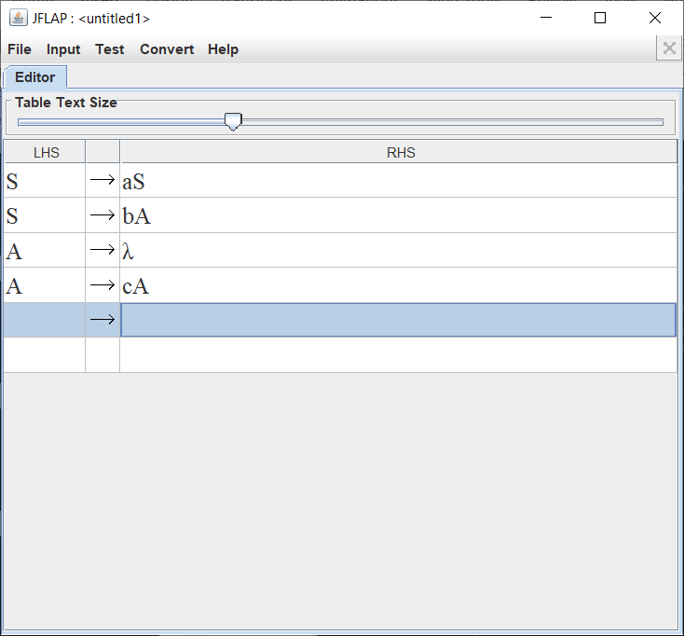
Regular Grammar Example
Of the Form: a*bc*

Slide 9
DFA and NFA
Deterministic refers to the uniqueness of the computation run.
There are Rules that a DFA obeys that an NFA does not.
A Null move is NOT allowed
The inability to transmit to any number of states for an input.
This means for a DFA to accept an input, then each state goes to another state for each unique input character and null is not one of them.
An NFA follows all the rules a DFA does except:
Null move IS allowed
The ability to transmit to any number of states for an input.
NOTE: DFA’s and NFA’s have equal computational power. Every NFA can be converted into a DFA and vice versa.

Slide 10
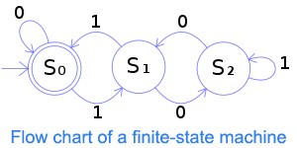
Stepping Through an Automata. (DFA pictured)
The double ring around S(0) denotes the final State, a DFA can have multiple final States.
The -> pointing to S(0) denotes the start State, there can only be one start state in a DFA.
The -> with numbers denotes what character is ‘consumed’ to get to the next state.
S(0) -> S(1); consuming 1.
S(0) -> S(0); consuming 0.
S(1) -> S(2); consuming 0.
S(1) -> S(0); consuming 1.
S(2) -> S(1); consuming 0.
S(2) -> S(2); consuming 1.
An accepting input for this particular DFA could be “1001” or “10111010”.

Slide 11
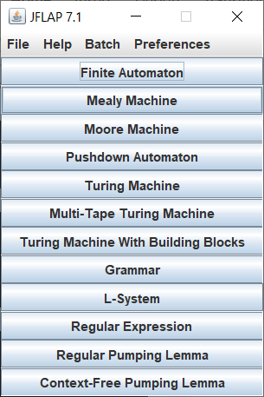
JFLAP Tutorial
JFLAP is software for experimenting with formal language topics such as DFAs and NFAs. This software is what we use for describing Automata.
This figure depicts all the different Machines, Automata, and Languages we can depict using JFLAP.

Slide 12
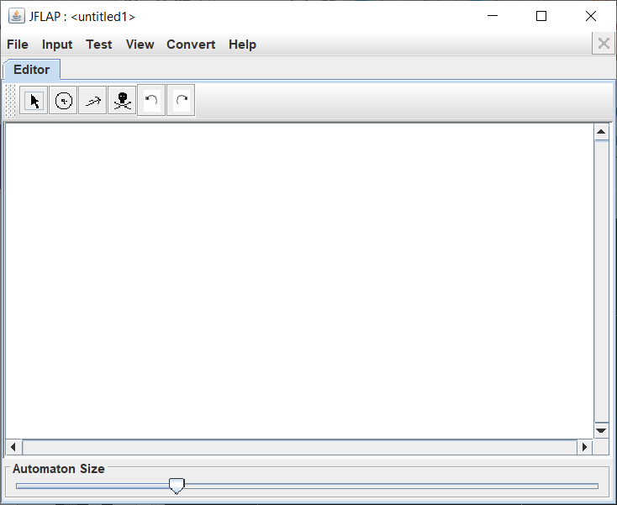
Making Automata in JFLAP
JFLAP has 6 main editors for making a Finite-State Automata. (From Left to Right)
Attribute Editor
State Creator
Transition Creator
Delete
Undo
Redo

Slide 13
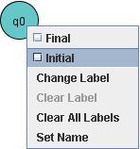
Attributes of States
There can only be one initial state and any number of final States.
(q: The initial State; F: The set of final states)
A string is to be accepted IF and ONLY IF the string is completely consumed and it is in the set of final states.

Slide 14

Transitions
A transition is denoted by an arrow, and the ‘consumed’ character is placed above the arrow. These attributes can be edited using the Attribute Editor.
The arrow that points to itself on q(0) is reflexive. Character ‘a’ will be consumed but the state will not change from q(0).

Slide 15
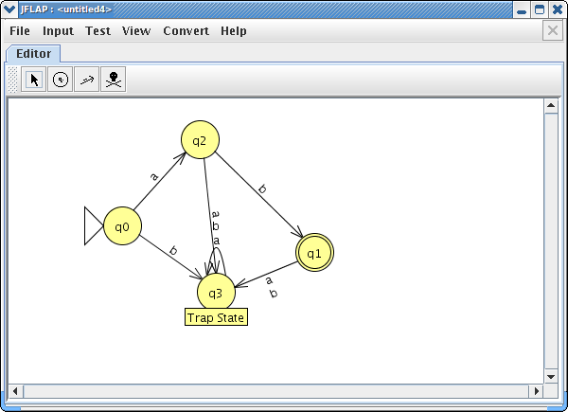
‘Dead State’ or ‘Trap State’
JFLAP has a built-in tool under the ‘Convert’ tab that allows the creator to add a ‘Trap State’.
The Trap State is used to be a state where the string will fail if it goes into said state.
Ex. This DFA will accept the string ‘ab’ and anything else will go into the Trap state, causing the input string to fail.

Slide 16
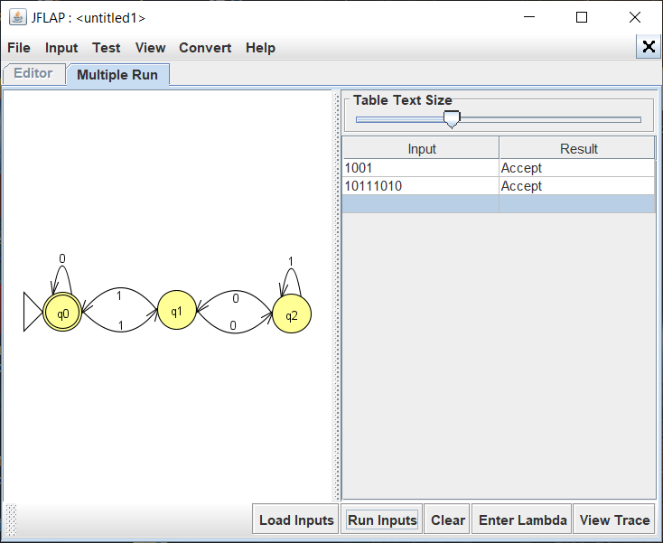
JFLAP Example (DFA)
In this example, a Dead State is not needed for the given input language; Σ : {1, 0}.
Each possible input transitions into another state, therefore this DFA is Complete.
This is the same Automata in the ‘Stepping through an Automata’ Slide.

Slide 17
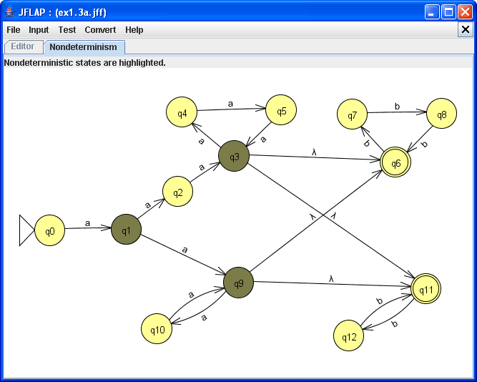
JFLAP Example (NFA)
JFLAP has a built-in tool to help solving NFA’s and which path is best to take. It is under ‘Test’ and is ‘Highlight Nondeterminism’.
This tool is useful because of the rule NFA’s follow that allow a singular input go to multiple states.
Ex. q(1) can go to either q(2) or q(9) on an ‘a’ character.

Slide 18
References and Cont. Reading
http://www.jflap.org/tutorial/
https://www.tutorialspoint.com/automata_theory/deterministic_finite_automaton.htm
https://www.geeksforgeeks.org/chomsky-hierarchy-in-theory-of-computation/

